Slide 1
eXtreme Programming

Slide 2
1. What is XP?

Slide 3


WHAT IS XP?
Notes:
켄트 벡 등이 제안한 소프트웨어 개발 방법론으로써,
요구사항이 시시각각 변하는 때에 적합한 방법이다.
10~12개의 Practice를 정의하고 있으며, 소규모 프로젝트에 적합하다.
켄트 벡은 실천 방법 뿐만 아니라 가치와 원칙, 목적에 대해서도 강조했다.

Slide 4
PURPOSE & FEATURE
Purpose of XP
‘Deliver well implemented software to customer in quick time’
XP do this using communication with customer and teams.
Feature of XP
Make test case first, then implement project using test case.

Slide 5
VALUE
XP’s key value
Courage
XP
Simple
Feedback
Respect
Communication

Slide 6
Principle
XP Important principle
Economy
Quality
Diversity
XP
Improvement
Flow
Mutual interests
Humanity
Self-examination
Failure
Self-similarity

Slide 7
2. XP Process

Slide 8
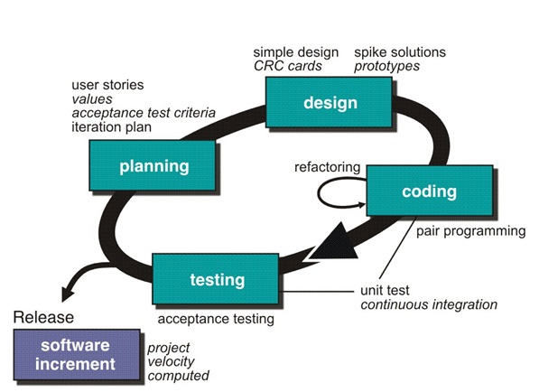
XP PROCESS
XP Iteration process

Slide 9
PLANNING
Release Planning절차
User fills
User story
Developer
Review
User story
Iteration
Plan Meeting
Notes:
Release plan: 전반적인 프로젝트에 대한 설계로, Iteration plan을 만들기 위해 쓰인다.
프로젝트와 관련된 모든 사람이 각자의 결정을 할 수 있게 하는 규칙을 가지고 있는데, 그 규칙은 일정을 협상하기 위한 방법을 제공한다.
핵심은 user story를 가지고서 프로그래밍에 걸리는 시간을
추정하는 것이다.
범위(scope), 자원(resources), 시간, 품질로 네 가지 요소에 기초하여 이루어진다.

Slide 10
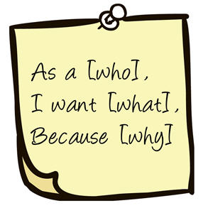
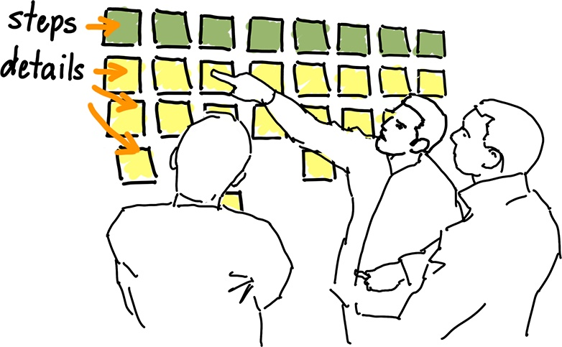
WHAT IS USER STORY?

Slide 11
DESIGN
Simply
Instinctively
Object Oriented
Core Funtions First
Priority First
With Continuos refactoring
Design.

Slide 12
How can we design Object Oriented?

Slide 13
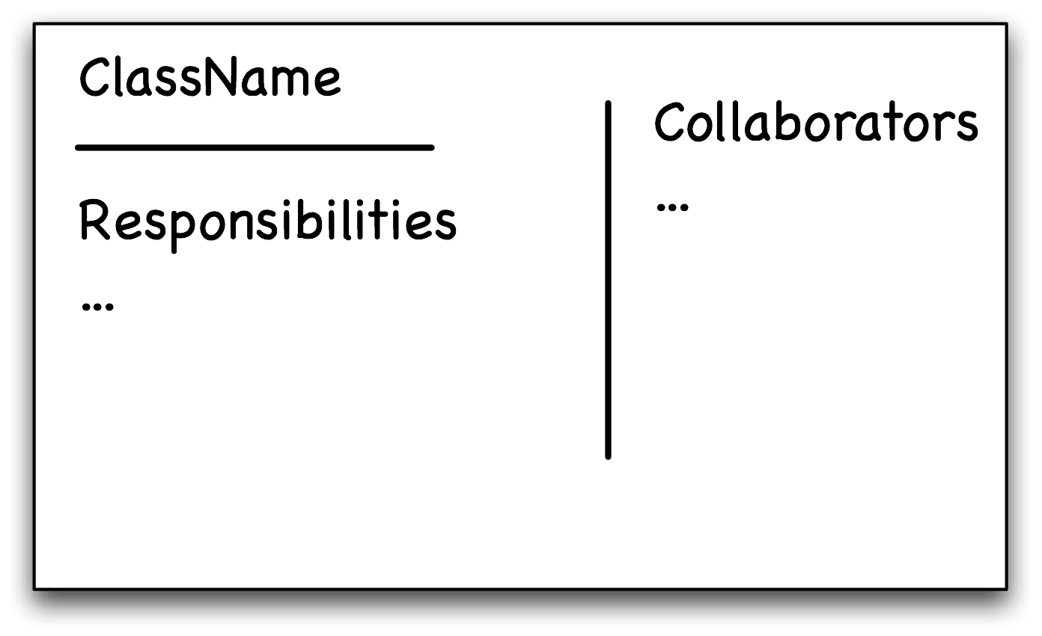
Using CRC Card!

Slide 14
CODING
Customer places First
Keep code standard
Unit test first
Two developer in one pair
Integrates step by step.
Use Separated computer for integration
Whole team shares Whole code.
How to develop?
devlop.
“Test-First Development”
“Collective Ownership”

Slide 15
Unit Test?
“Prove there’s no error in module”
Pros
Easy to coding!
Easy to edit!
Easy to collapse!
Cons
Need more Effort

Slide 16
Pair Programming?
“Two developers with one computer!”
WHY?
Faster development speed
Decrease error rate
Decrease troubleshooting time

Slide 17
TESTING
Unit Test is necessary!
Acceptence Test
Verify implement by User Story unit.

Slide 18
Small Release
Caculate Velocity
to plan schedule
more accurate.
Show prototype to customer
And get Feedback.
Then get new Requirment from customer.

Slide 19
Velocity?
Project implement speed.
Number of user stories implemented in one iteration

Slide 20
3. Managing

Slide 21
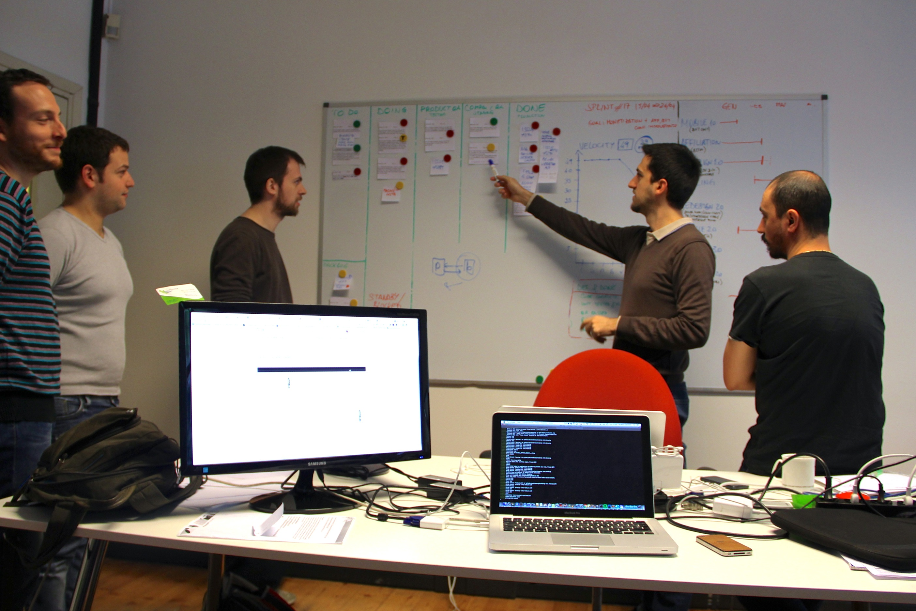
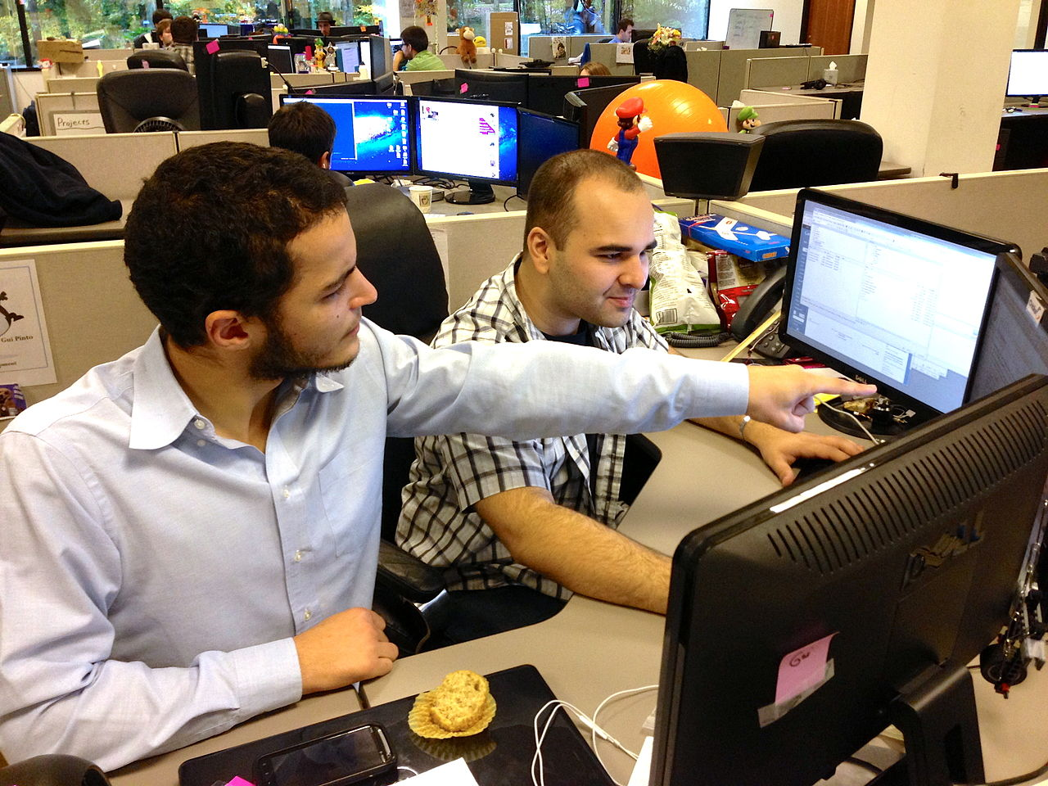

3
Open Team Workspace.
MANAGING

Slide 22
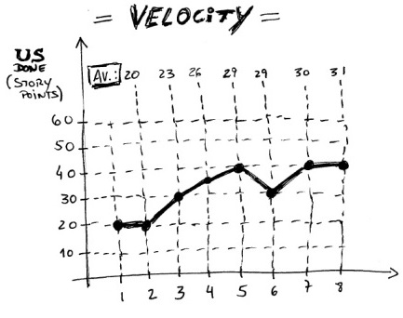
By calculating Velocity,
Plan schedule more accurate.
3
MANAGING

Slide 23
Fix XP WHEN IT BREAKS!
You don’t have to stick a plan.
You can always change it, if needed.

Slide 24
HIGH MAINTAINABILITY
XP Pros
HIGH FLEXIBILITY

Slide 25
CONCRETE RESPONSIBILITY
TESTABILITY

Slide 26
LIGHT
REALISTIC
&
VISIBLE
EXPLAINABLE

Slide 27
LOW COST
@
XP

Slide 28
1. XP needs at least one Veteran. 2. Customer Centered Excessively. 3. Teamwork overly enforced. 4. Hard to apply to large project.
Cons

Slide 29

THANKS!
Do U have any questions?

